Slide 1



UNIVERSITY INSTITUTE OF ENGINEERING
COMPUTER SCIENCE ENGINEERING
Bachelor of Engineering
Cloud Computing(CST-411)
Prepared By: Ms Himanshu(E11818)
Topic: Introduction to Cloud Computing and its Architecture
DISCOVER . LEARN . EMPOWER

Slide 2
Learning Objectives & Outcomes
Objective:
To understand the meaning of Cloud Computing and its Architecture
Outcome:
Student will understand
The meaning of Cloud Computing
Its Architecture

Slide 3

Cloud Computing

Slide 4
Overview
What is Cloud Computing?
History of Cloud Computing
Need of Cloud Computing?
Evolution Of Cloud Computing
Characteristics of Cloud Computing Applications
Cloud Computing Architecture
Components of Cloud Computing Architecture
How Cloud storage works
Benefits of Cloud Computing Architecture

Slide 5
Cloud Computing
In Simplest terms, cloud computing means storing and accessing the data and programs on remote servers that are hosted on internet instead of computer’s hard drive or local server.
Cloud computing is also referred as Internet based computing.
In other words, we can say that Cloud computing means on demand delivery of IT resources via the internet with pay-as-you-go pricing. It provides a solution of IT infrastructure in low cost

Slide 6
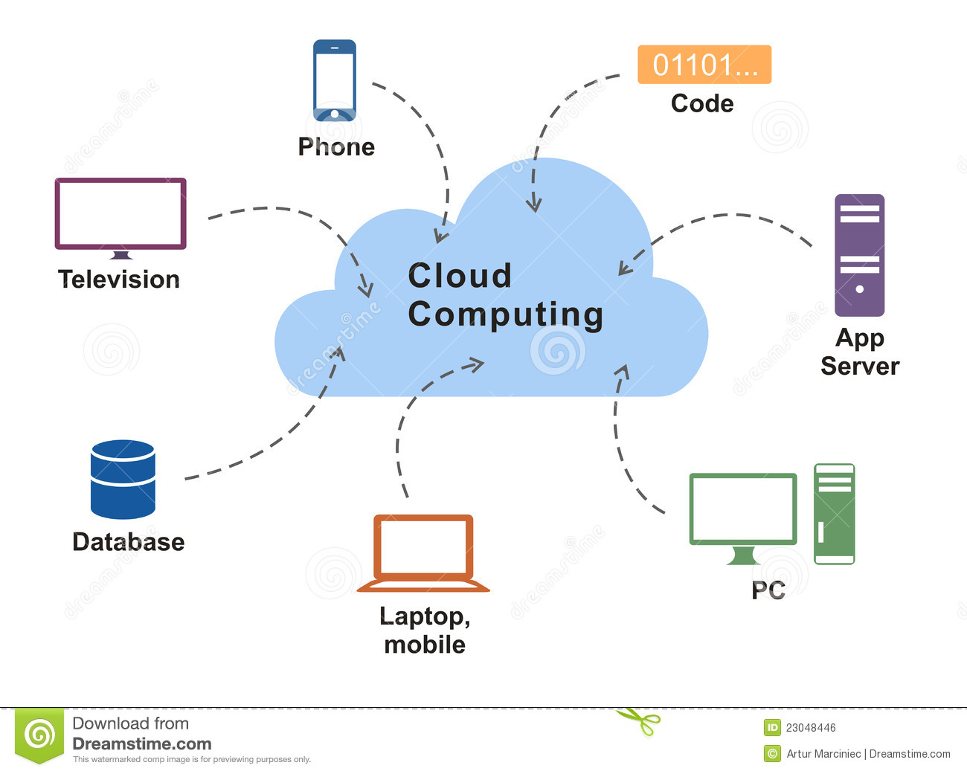

Slide 7
History Of Cloud Computing
At around in 1961, John MacCharty suggested in a speech at MIT that computing can be sold like a utility, just like a water or electricity.
It was a brilliant idea, but like all brilliant ideas, it was ahead if its time, as for the next few decades, despite interest in the model, the technology simply was not ready for it.
But of course, time has passed and the technology caught that idea and after few years we mentioned that:
In 1999, Salesforce.com started delivering of applications to users using a simple website. The applications were delivered to enterprises over the Internet, and this way the dream of computing sold as utility were true.

Slide 8
Cont..
Before Computing was come into existence, client Server Architecture was used where all the data and control of client resides in Server side.
If a single user want to access some data, firstly user need to connect to the server and after that user will get appropriate access.
But it has many disadvantages. So, After Client Server computing, Distributed Computing was come into existence, in this type of computing all computers are networked together with the help of this, user can share their resources when needed.
It also has certain limitations. So in order to remove limitations faced in distributed system, cloud computing was emerged.

Slide 9
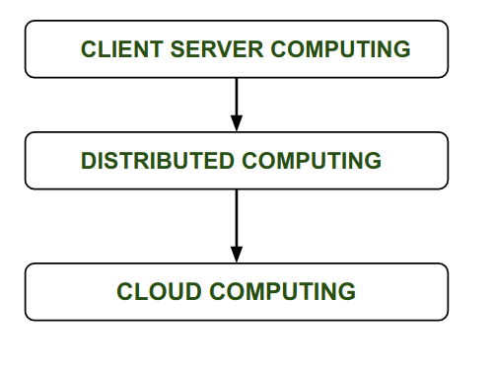

Slide 10
After that in 2009, Google Play also started providing Cloud Computing Enterprise Application as other companies will see the emergence of cloud Computing ;
They also started providing their cloud services. Thus, in 2009, Microsoft launch Microsoft Azure and after that other companies like Alibaba, IBM, Oracle, HP also introduces their Cloud Services.
In today the Cloud Computing become very popular and important skill.

Slide 11
Contd…
In 2002, Amazon started Amazon Web Services, providing services like storage, computation and even human intelligence.
However, only starting with the launch of the Elastic Compute Cloud in 2006 a truly commercial service open to everybody existed.
In 2009, Google Apps also started to provide cloud computing enterprise applications

Slide 12
Characteristics of Cloud Computing
There are following characteristics of Cloud Computing.
Agility
The cloud works in the distributed computing environment. It shares resources among users and works very fast.
High availability and reliability
Availability of servers is high and more reliable, because chances of infrastructure failure are minimal.
High Scalability
Means "on-demand" provisioning of resources on a large scale, without having engineers for peak loads.
Multi-Sharing
With the help of cloud computing, multiple users and applications can work more efficiently with cost reductions by sharing common infrastructure.

Slide 13
Contd…
Device and Location Independence
Cloud computing enables the users to access systems using a web browser regardless of their location or what device they use e.g. PC, mobile phone etc.
Maintenance
Maintenance of cloud computing applications is easier, since they do not need to be installed on each user's computer and can be accessed from different places. So, it reduces the cost also.
Low Cost
By using cloud computing, the cost will be reduced because to take the services of cloud computing, IT company need not to set its own infrastructure and pay-as-per usage of resources.

Slide 14
Applications of Cloud Computing in real-world
Online Data Storage
Backup and Recovery
Big Data Analysis
Testing and Development
Anti-Virus Applications
Ecommerce Application
Cloud computing in education
Cloud Computing in Medical Fields

Slide 15
Evolution of Cloud Computing
Cloud computing is all about renting computing services. This idea first came in the 1950s.
In making cloud computing what it is today, five technologies played a vital role.
These are distributed systems and its peripherals, virtualization, web 2.0, service orientation, and utility computing.

Slide 16
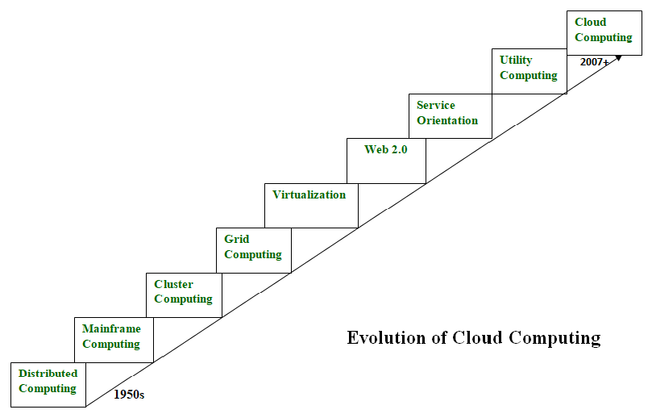

Slide 17
Distributed Systems:
It is a composition of multiple independent systems but all of them are depicted as a single entity to the users.
The purpose of distributed systems is to share resources and also use them effectively and efficiently.
Distributed systems possess characteristics such as scalability, concurrency, continuous availability, heterogeneity, and independence in failures.
But the main problem with this system was that all the systems were required to be present at the same geographical location.
Thus to solve this problem, distributed computing led to three more types of computing and they were-Mainframe computing, cluster computing, and grid computing.

Slide 18
Mainframe computing:
Mainframes which first came into existence in 1951 are highly powerful and reliable computing machines.
These are responsible for handling large data such as massive input-output operations. Even today these are used for bulk processing tasks such as online transactions etc.
These systems have almost no downtime with high fault tolerance. After distributed computing, these increased the processing capabilities of the system.
But these were very expensive. To reduce this cost, cluster computing came as an alternative to mainframe technology.

Slide 19
Cluster computing:
In 1980s, cluster computing came as an alternative to mainframe computing.
Each machine in the cluster was connected to each other by a network with high bandwidth.
These were way cheaper than those mainframe systems. These were equally capable of high computations. Also, new nodes could easily be added to the cluster if it was required.
Thus, the problem of the cost was solved to some extent but the problem related to geographical restrictions still pertained.
To solve this, the concept of grid computing was introduced.

Slide 20
Grid computing:
In 1990s, the concept of grid computing was introduced.
It means that different systems were placed at entirely different geographical locations and these all were connected via the internet.
These systems belonged to different organizations and thus the grid consisted of heterogeneous nodes. Although it solved some problems but new problems emerged as the distance between the nodes increased.
The main problem which was encountered was the low availability of high bandwidth connectivity and with it other network associated issues.
Thus. cloud computing is often referred to as “Successor of grid computing”.

Slide 21
Virtualization:
It was introduced nearly 40 years back.
It refers to the process of creating a virtual layer over the hardware which allows the user to run multiple instances simultaneously on the hardware.
It is a key technology used in cloud computing. It is the base on which major cloud computing services such as Amazon EC2, VMware v Cloud, etc work on.
Hardware virtualization is still one of the most common types of virtualization.

Slide 22
Web2.0:
It is the interface through which the cloud computing services interact with the clients.
It is because of Web 2.0 that we have interactive and dynamic web pages.
It also increases flexibility among web pages. Popular examples of web 2.0 include Google Maps, Facebook, Twitter, etc.
Needless to say, social media is possible because of this technology only. It gained major popularity in 2004.

Slide 23
Service orientation:
It acts as a reference model for cloud computing.
It supports low-cost, flexible, and evolvable applications.
Two important concepts were introduced in this computing model.
These were Quality of Service (QoS) which also includes the SLA (Service Level Agreement) and Software as a Service (SaaS).
Utility computing:
It is a computing model that defines service provisioning techniques for services such as compute services along with other major services such as storage, infrastructure, etc which are provisioned on a pay-per-use basis.

Slide 24
Cloud Computing Architecture

Slide 25
Architecture
As we know, cloud computing technology is used by both small and large organizations to store the information in cloud and access it from anywhere at anytime using the internet connection.
Cloud computing architecture is a combination of service-oriented architecture and event-driven architecture.
Cloud computing architecture is divided into the following two parts
Front End
Back End

Slide 26
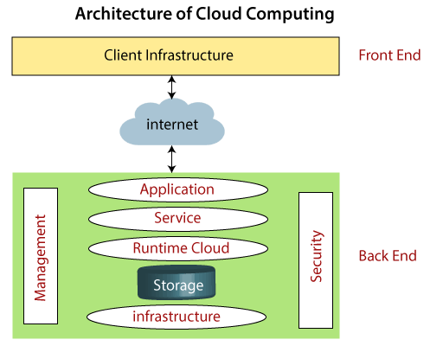

Slide 27
Components of Cloud Computing Architecture
There are the following components of cloud computing architecture –
1. Client Infrastructure
Client Infrastructure is a Front-end component. It provides GUI (Graphical User Interface) to interact with the cloud.
2. Application
The application may be any software or platform that a client wants to access.
3. Service
A Cloud Services manages that which type of service you access according to the client’s requirement.
Cloud computing offers the following three type of services:
i. Software as a Service (SaaS) – It is also known as cloud application services. Mostly, SaaS applications run directly through the web browser means we do not require to download and install these applications. Some important example of SaaS is given below –
Example: Google Apps, Salesforce Dropbox, Slack, Hubspot, Cisco WebEx.

Slide 28
ii. Platform as a Service (PaaS) –
It is also known as cloud platform services. It is quite similar to SaaS, but the difference is that PaaS provides a platform for software creation, but using SaaS, we can access software over the internet without the need of any platform.
Example: Windows Azure, Force.com, Magento Commerce Cloud, OpenShift.
iii. Infrastructure as a Service (IaaS) –
It is also known as cloud infrastructure services. It is responsible for managing applications data, middleware, and runtime environments.
Example: Amazon Web Services (AWS) EC2, Google Compute Engine (GCE), Cisco Metapod.
4. Runtime Cloud
Runtime Cloud provides the execution and runtime environment to the virtual machines.
5. Storage
Storage is one of the most important components of cloud computing. It provides a huge amount of storage capacity in the cloud to store and manage data.

Slide 29
6. Infrastructure
It provides services on the host level, application level, and network level. Cloud infrastructure includes hardware and software components such as servers, storage, network devices, virtualization software, and other storage resources that are needed to support the cloud computing model.
7. Management
Management is used to manage components such as application, service, runtime cloud, storage, infrastructure, and other security issues in the backend and establish coordination between them.
8. Security
Security is an in-built back end component of cloud computing. It implements a security mechanism in the back end.
9. Internet
The Internet is medium through which front end and back end can interact and communicate with each other.

Slide 30
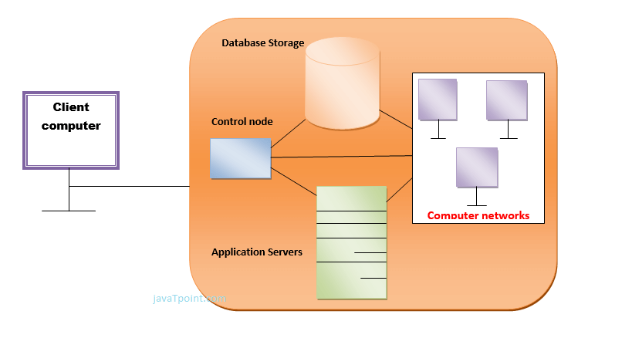
How Does Cloud Storage Work?

Slide 31
Benefits of Cloud Computing Architecture
It solves latency issues and improves data processing requirements
It reduces IT operating costs and gives good accessibility to access data and digital tools
It helps businesses to easily scale up and scale down their cloud resources
It has a flexibility feature which gives businesses a competitive advantage
It results in better disaster recovery and provides high security
It automatically updates its services
It encourages remote working and promotes team collaboration

Slide 32
References
Text books:
Buyya, Rajkumar, James Broberg, and Andrzej M. Goscinski, eds. Cloud computing: Principles and paradigms. Vol. 87. John Wiley & Sons, 2010.
Miller, Michael. Cloud computing: Web-based applications that change the way you work and collaborate online. Que publishing, 2008
Websites:
https://www.javatpoint.com/introduction-to-cloud-computing
https://www.geeksforgeeks.org/real-world-applications-of-cloud-computing/
https://www.javatpoint.com/cloud-computing-architecture
https://www.simplilearn.com/tutorials/cloud-computing-tutorial/cloud-computing-architecture

Slide 33
THANK YOU

